Slide 1

New York Community College Trustees
Narcisa A. Polonio, Ed.D.
Executive Vice President for Research, Education and Board Services
Association of Community College Trustees
Washington, DC
October 20, 2017

Slide 2
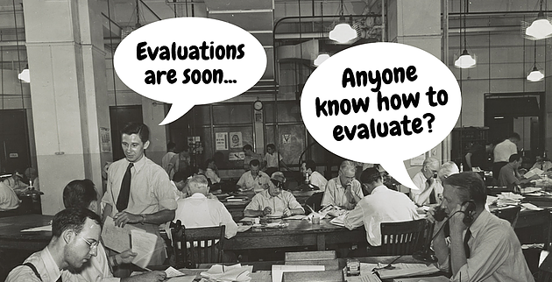

Slide 3

Presidential Evaluation
©2017 Association of Community College Trustees. (ACCT) Not for distribution

Slide 4
Why do many boards find it difficult to conduct the president’s evaluation?
  Not the typical subordinate-supervisor relationship
  Level of complexity of the relationship
  It is easy to avoid
  Other priorities
  Lack of agreement and process
©2017 Association of Community College Trustees. (ACCT) Not for distribution

Slide 5
What Are The Rewards?
Set goals and priorities
Enhance knowledge of the institution
Commitment to nurture and support
Focus on expectations and outcomes
Respect and improved communication
Ownership and pride in the process
Greater trust and respect
©2017 Association of Community College Trustees. (ACCT) Not for distribution

Slide 6

Presidential Evaluation
Evaluating the president is one of the central functions of the Board of Trustees.
A mutually agreeable evaluation process creates a proactive forum where the leadership needs of the institution, and the new and emerging leadership role for the board and president, can be considered.
©2017 Association of Community College Trustees. (ACCT) Not for distribution

Slide 7
Presidential Evaluation
Helping Boards and Presidents
Strengthen and Build the Relationship.
Get to know the expectation of all board members and the president.
©2017 Association of Community College Trustees. (ACCT) Not for distribution

Slide 8
Presidential Evaluation…
Should be a rewarding experience
Provides an opportunity for the board to take stock of his or her contributions
Establishes a learning agenda around emerging issues and needs
Strengthens the board/president relationship
Clarifies expectations of the Board and President
Fulfills contractual obligations
Develops a positive climate for growth
©2017 Association of Community College Trustees. (ACCT) Not for distribution

Slide 9
Different Approaches
Instrument becomes basis for evaluation
Delegate to Chair of the Board or small group of trustees
Hire consultant to conduct interviews and report to Board
Review President’s self report
“Leave well enough alone”
Structured discussion w/ Chair
No evaluation
General discussion
Assessment instrument
Comprehensive approach
Presidential evaluations
©2017 Association of Community College Trustees. (ACCT) Not for distribution

Slide 10
The Goal Should Be: Work as a Team
Support the President & Board Partnership
Make evaluation a rewarding experience
Strengthen and build a harmonious Board/President relationship
Clarify expectations of board and president
Learn as a team
Be clear on expectations and time frame
Fulfill contractual obligations
Develop a positive climate for growth
©2017 Association of Community College Trustees. (ACCT) Not for distribution

Slide 11

Good to Great Team
Reflect on roles and responsibilities
Conduct in a professional manner
Base on mutual decisions
Strengthen leadership
Enable the office of the president
Focus on both short-term and long-term interests of the institution
Be open and value each contribution
©2017 Association of Community College Trustees. (ACCT) Not for distribution

Slide 12
Questions
Should the faculty and staff be involved?
Is a 360º appraisal a reasonable way to go?
What other methods are used in higher education?
Is the appraisal approach appropriate for a higher education environment?
How does a Board assess the President without it ending up on the front page of the newspaper?
How often should the CEO be evaluated?
What criteria should be used?
How should information be gathered?
What should be done with the evaluation results?
What are the implications on the contract and compensation?
Source: Cindra Smith, Trustee Handbook, ACCT
©2017 Association of Community College Trustees. (ACCT) Not for distribution

Slide 13
The Process
Focus on priorities
Cover as many different topics as you can
Involve the president
Involve all of the board
Focus on the positive
Think long-term
Understand the complexity of the presidency
Study leadership
Study how other colleges conduct presidential evaluations
©2017 Association of Community College Trustees. (ACCT) Not for distribution

Slide 14

What We Have Learned
The Process Should Be:
Comprehensive and include
  The Status of the College
  The President’s Self-evaluation
  The Board Evaluation of the president
Timely
Fair
Collaborative
©2017 Association of Community College Trustees. (ACCT) Not for distribution

Slide 15
Checklist
President Contract –Parameters and expectations; terms; contractual and legal requirements
Planning & Timeline – How often?
Process – Who should be involved?
Instrument and Documentation – Use data and supporting information
Discussion and Consensus – Share information
Formal Agreements and Next Steps
©2017 Association of Community College Trustees. (ACCT) Not for distribution

Slide 16
Examples of Assessment Categories
Institutional Performance
Committed Leadership focused on Student Success
Organizational Strategy
Institutional Leadership
External Relations
Community Engagement
Partnerships
Communications
Budgetary/Fiscal Management
Board-President Relations
Fundraising
Specific Performance Goals for the Upcoming Year
©2017 Association of Community College Trustees. (ACCT) Not for distribution

Slide 17
Presidential Performance Assessment Instrument
Input from All Trustees
Respondents rate the president’s performance according to a 5-point scale:
5=Significantly Exceeds Expectations
4=Exceeds Some Expectations
3=Meets Expectations
2=Meets Some Expectations
1=Does Not Meet Expectations
Don’t Know
©2017 Association of Community College Trustees. (ACCT) Not for distribution

Slide 18
Sample Assessment Items
Institutional Performance
Provides effective leadership in establishing and maintaining excellent student services.
Institutional Leadership
Implements College operations pursuant to policy, statutes, and regulations.
Board-President Relations
Communicates with board members to inform and resolve issues of interest.
©2017 Association of Community College Trustees. (ACCT) Not for distribution

Slide 19
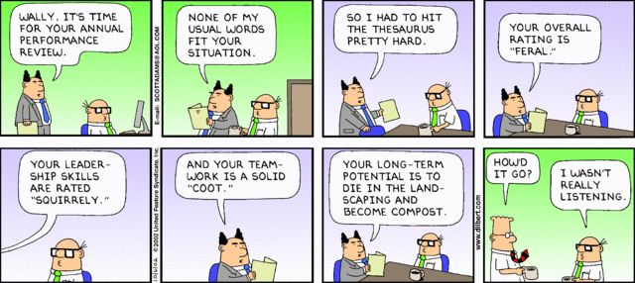
Planning and Timeline
How Often?

Slide 20
Plan the Process
Study how other colleges conduct
presidential evaluations
Involve the president
Involve all of the board
Focus on the positive
Think long-term
Focus on priorities
Understand the complexity of the presidency
Cover as many different topics as you can
Study leadership
©2017 Association of Community College Trustees. (ACCT) Not for distribution

Slide 21
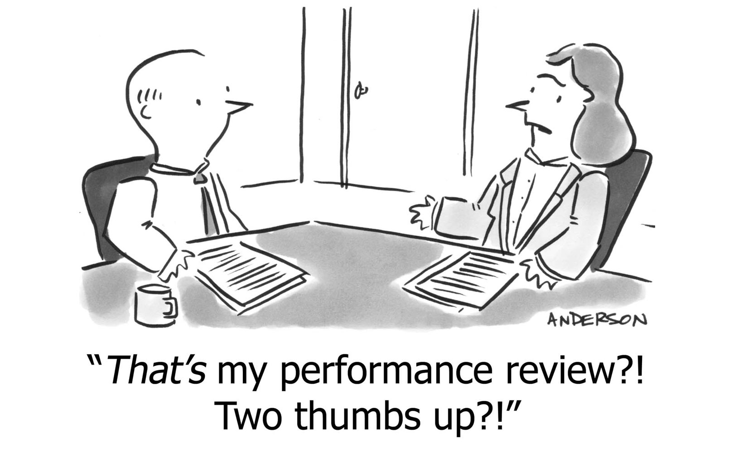
PROCESS
Focus on priorities
Cover as many different topics as you can
©2017 Association of Community College Trustees. (ACCT) Not for distribution

Slide 22
Collect Input from All Trustees
Presidential Performance Instrument
Performance Rating Scale:
5-Significantly Exceeds Expectations
4-Exceeds Some Expectations
3-Meets Expectations
2-Meets Some Expectations
1-Does Not Meet Expectations
Don’t Know
To get numerical averages, respondents might be asked to rate the statement according to a scale
©2017 Association of Community College Trustees. (ACCT) Not for distribution

Slide 23
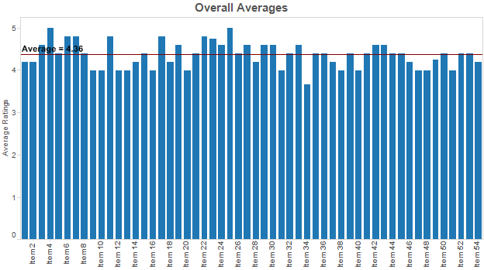
Sample Layout of Assessment Averages
©2017 Association of Community College Trustees. (ACCT) Not for distribution

Slide 24
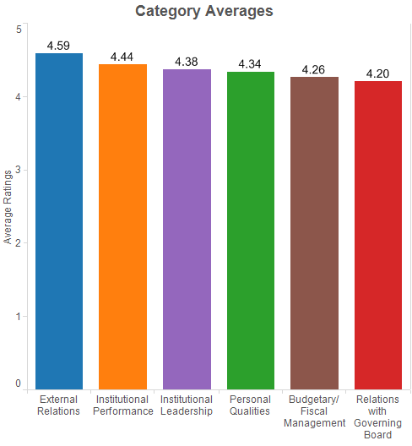
Sample of Category Averages
©2017 Association of Community College Trustees. (ACCT) Not for distribution

Slide 25
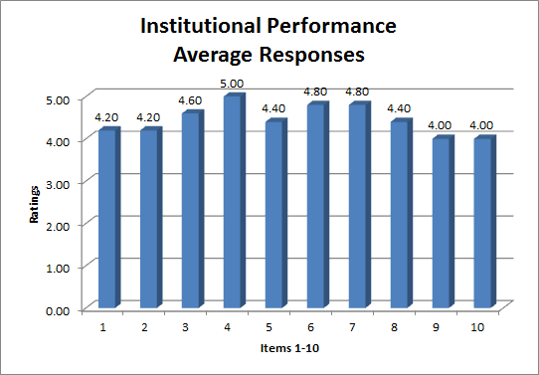
Samples of Comparative Responses to Individual Items
©2017 Association of Community College Trustees. (ACCT) Not for distribution

Slide 26
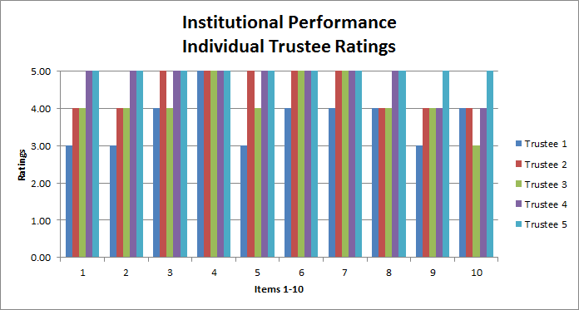
Samples of Comparative Responses to Individual Items
©2017 Association of Community College Trustees. (ACCT) Not for distribution

Slide 27
Sample Open Ended Questions
What initiatives/projects should the president focus on over the next year?
Assessment of performance goals for 2017-2018?
©2017 Association of Community College Trustees. (ACCT) Not for distribution

Slide 28
Discussion and Review
Board discussion: Set goals, priorities, target dates, and the time frame for the next evaluation and self-assessment process.
After discussion: Board should present a formal and unified message to the president, and could include:
  Compensation
  Extension of contract
  Resolution of performance and/or perception issues
  Goals and priorities for next year
  List of concerns & needs improvements
  Periodic review
  Schedule for next evaluation
©2017 Association of Community College Trustees. (ACCT) Not for distribution

Slide 29

President Contract
Parameters and Expectations
Review Terms
Define contractual and legal requirements
©2017 Association of Community College Trustees. (ACCT) Not for distribution

Slide 30
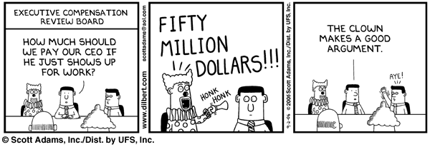

Slide 31
Questions?

Slide 32

Thank You!
ACCT Retreats & Board Services
Contact us at:
Narcisa Polonio
202▪276▪1983
Npolonio@acct.org
www.trustee-education.org

